Slide 1
URL Shortening Web Application Report
~Sai Chandu Sunkara

Slide 2
WHY URL SHORTENING? Navigating and sharing long URLs is a pain. The reason behind so long URLs is the number of trackers in a link, loaded up content (multiple directories) of heavy sites, etc. We all use URL shortening applications for that purpose to shorten the long URLs to a few characters, which makes them easier to share and navigate through and also look clean and elegant.

Slide 3
Ever wondered about coding a URL shortening application yourself? In this report, I will explain you the things which are needed for the creation of URL shortening application and which were implemented by me during the creation of a of this project.

Slide 4
The project consists of 3 parts: 1) Frontend (done with HTML, CSS and Bootstrap). 2) Database connection – Database ORM (SQL Alchemy) 3) Flask (Python) backend. Front-End Information: The front-end consists of 2 web pages: 1. Home Page - A page will be shown where the user can enter the URL he/she wants to shorten. After the ‘shorten’ button is clicked, the shortened URL is displayed in the text-field which the user can copy using the copy button. 2. History Page - Containing all the Original URLs along with the Shortened URLs.

Slide 5
Project Workflow: 1. Users can enter the URL they want to shorten. After entering a URL, click on the ‘Shorten’ URL button to display the shortened URL in the following text-field which can be copied by clicking on the copy button. 2. After the ‘Shorten’ button is clicked, the URL that is entered is saved in our database with the shortened URL. It is saved in the database so that the user can look into the previous URLs he entered in our web-app with their shortened URL. 3. Try to verify the URL entered by the user is correct or not.

Slide 6
Modules imported were as follows: import os import pyshorteners from flask import Flask, render_template, request from flask_sqlalchemy import SQLAlchemy from flask_migrate import Migrate

Slide 7
Following Steps are implemented:
Build a basic app.py and import the required modules from the given packages and code the basic flask template.
Create a folder inside the project folder (root directory od app.py) and name it templates.
Create 3 HTML files inside templates folder and name them “layout.html”, “home.html” and “history.html”.
Go to the root directory of app.py and create a new sqlite database using command prompt with admin access with 3 fields as “id” (Primary Key), “long” and “short”.
“layout.html” should contain all the basic template code with the navigation bar and should contain block for inheritance.
Build “home.html” and “history.html” using the concept of inheritance from “layout.html” and should contain relevant request, forms and display content.
Give a CSS styling to both the HTML files.
In “history.html” add a button to copy the shorten URLs using JavaScript code snippets.
In app.py first locate the root directory (base folder) of app.py using “os” module and store it in a variable.
Configure the SQLAlchemy ORM configurations and use the variable to store path using os module to give the path of SQLite database.
Once done with all the importing and merging of the backend server to the database server. Implement the remaining codes in the frontend and backend.

Slide 8
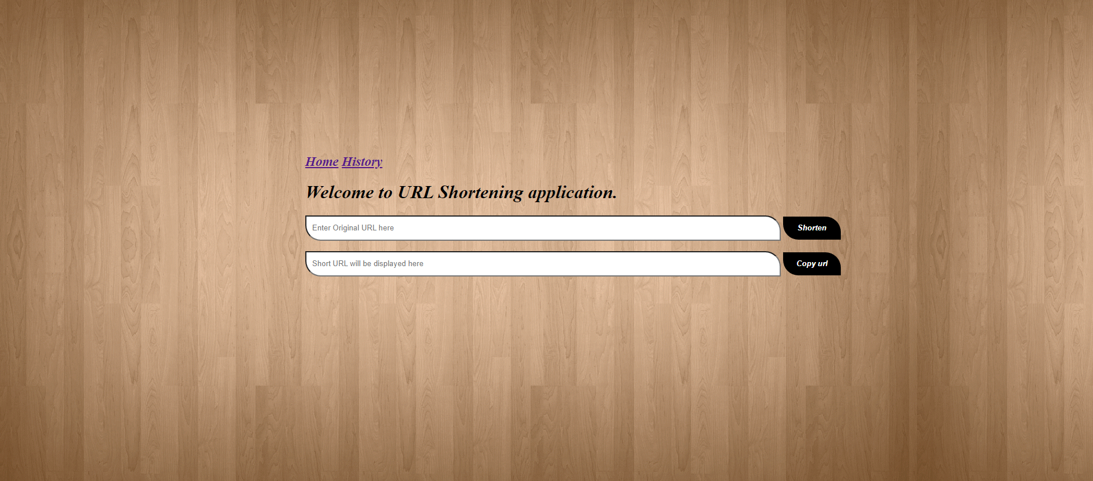
Website after Running the application.
LinkedIn: Sai Chandu Sunkara | LinkedIn
GitHub: saichandu04 (sai chandu sukara) (github.com)

